Slide 1
Linux device driver
Day 24 PPT
-SUBITHRA s

Slide 2
LINUX DEVICE DRIVER
Types of linux drivers:
Character device drivers: handle devices that transfer data in a stream of bytes, such as keyboards, mice, serial ports, and terminals.
Block device drivers: manage devices that store and retrieve data in fixed-size blocks, like hard drives, ssds, and usb storage devices.
Network device drivers: control networking devices such as ethernet adapters, wi-fi cards, and network interfaces.
Filesystem drivers: implement file system types to allow the kernel to access different file systems, such as ext4, ntfs, and fat32.
Miscellaneous drivers: cover other types of devices or functionalities, such as random number generators, virtual devices, and system-specific functionalities.
Initialization and cleanup functions:
Module_init and module_exit: specify the initialization and cleanup functions of the driver module.
__Init and __exit macros: mark functions as initialization or exit functions to optimize memory usage.
Data structures:
Struct file_operations: contains pointers to functions handling device operations like open, close, read, and write.
Device-specific data structures: custom structures to store device-specific information or configuration.

Slide 3
Device operation functions:
Open, release: handle device open and close operations.
Read, write: manage reading from and writing to the device.
Ioctl: handle device-specific control operations.
Kernel apis and macros:
Printk: log messages to the kernel log for debugging and informational purposes.
Copy_to_user, copy_from_user: safely copy data between user space and kernel space.
Register_chrdev, unregister_chrdev: register and unregister character device drivers.
Interrupt handling (for hardware drivers):
Request_irq, free_irq: manage interrupts from hardware devices.
Irq_handler_t: define interrupt handler functions.
Locking mechanisms:
Mutex_lock, mutex_unlock: implement mutual exclusion to prevent race conditions.
Spin_lock, spin_unlock: provide spin locks for low-level synchronization.
Memory management:
Kmalloc, kfree: allocate and free kernel memory.
Vmalloc, vfree: allocate and free virtual memory.

Slide 4
Hardware access:
I/O memory access: access device registers and memory-mapped I/O.
Direct memory access (dma): transfer data between devices and memory without cpu intervention.
Power management (for mobile and embedded devices):
Suspend, resume: handle device suspend and resume operations.
Power_on, power_off: control device power states.
Driver development process:
Understanding hardware: know the hardware specifications, communication protocols, and data transfer mechanisms.
Writing driver code: implement device-specific functionalities using appropriate kernel apis, data structures, and operation functions.
Compiling and loading: use the kernel build system (make) to compile the driver module and load it into the kernel (insmod or modprobe).
Testing and debugging: test the driver with user-space applications, debug using kernel log messages (dmesg), and address any issues or bugs.
Documentation and maintenance: document the driver's functionalities, compatibility, and usage. Keep the driver updated and maintain compatibility with kernel updates.

Slide 5
Header File Inclusions:
linux/init.h: Includes functions for module initialization. linux/module.h: Includes functions for module management. linux/fs.h: Includes file system-related functions. linux/uaccess.h: Includes functions for user space access.
Definitions:
DEVICE_NAME: Defines the name of the character device.
BUF_LEN: Defines the length of the message buffer.
Module Information:
MODULE_LICENSE("GPL"): Specifies the license under which the module is distributed (GPL in this case).
MODULE_AUTHOR("Your Name"): Specifies the author of the module.
MODULE_DESCRIPTION("A simple character device driver"): Provides a description of the module.
Static Variables:
Major: Holds the major number of the registered device.
msg: Static array to hold the message buffer.
msg_Ptr: Pointer to the message buffer.

Slide 6
Device Operation Functions:
device_open: Handles device open operation. It logs a message indicating the device is opened. device_release: Handles device close operation. It logs a message indicating the device is closed. device_read: Handles device read operation. Copies characters from the message buffer to the user buffer. device_write: Handles device write operation. Copies the message from the user buffer to the message buffer.
File Operations Structure (struct file_operations):
Defines a structure containing pointers to the device's file operation functions (read, write, open, release).
Initialization and Exit Functions:
chardev_init: Initialization function for the module. Registers the character device using register_chrdev and logs messages accordingly.
chardev_exit: Exit function for the module. Unregisters the character device using unregister_chrdev and logs a message indicating unregistration.
Module Initialization and Exit:
module_init(chardev_init): Specifies the initialization function of the module. module_exit(chardev_exit): Specifies the cleanup function of the module.

Slide 7
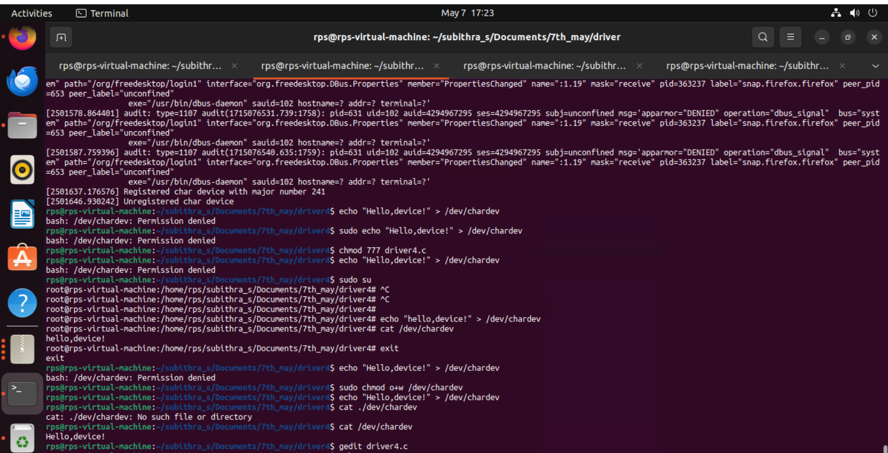

Slide 8
THANK YOU

